Slide 1



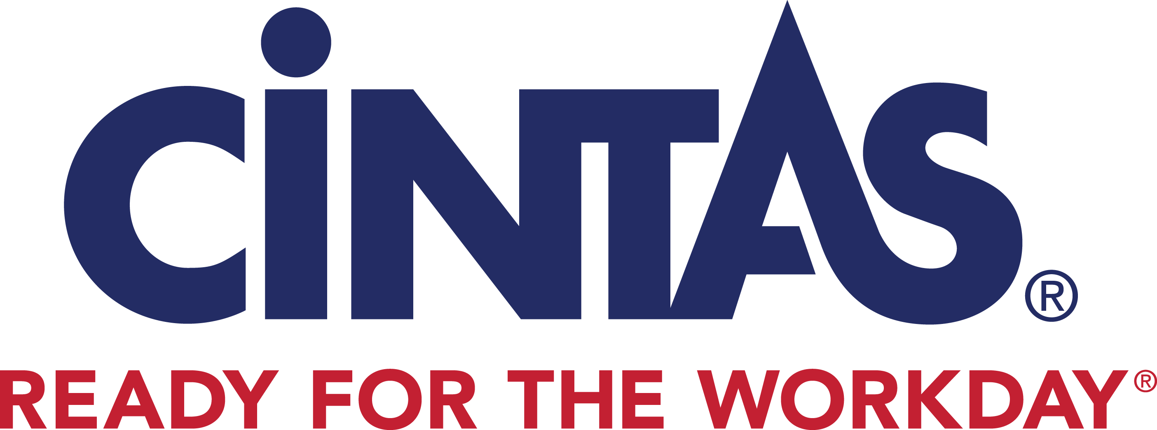


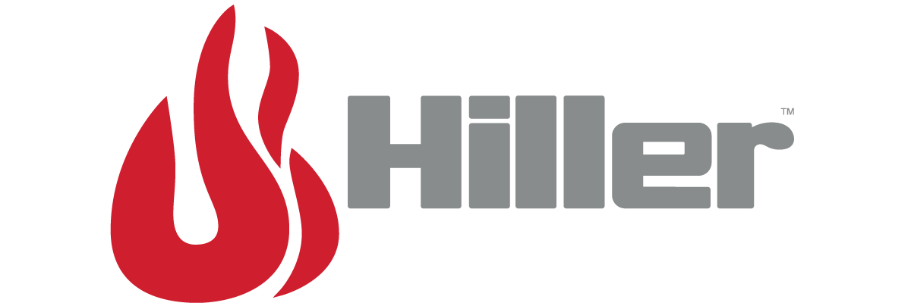



Brand ratings: Sphere mid of the pack on advocacy with a 3.8 avg. rating; Guardian leads with 4.9, followed by National-level brands
overall_0_131740350649972884 columns_1_131740338247856450 6_1_131740338246954055 9_1_131740338247154583 12_1_131740338247345185 13_1_131740338247596111 19_1_131740350340356512 22_1_131740350520505784 26_1_131740351718073034 29_1_131740360203575201
consumer sentiment
Low N
Sphere
Regional
National FLS
Regional
Note: Net sentiment = % 4 & 5 ratings minus % 1 & 2 ratings
Source: Google Reviews

Slide 2
Ratings overtime: After peaking in 2023, dip seen in Sphere’s sentiment over the last year
Consumer sentiment
 | Avg. 2019-21 | Avg. 2022-24 | Pts. change in avg. rating
 | 4.9 | 4.8 | -0.04
 | 3.3 | 4.6 | 1.3
 | 4.5 | 4.1 | -0.3
 | 4.7 | 4.1 | -0.5
 | 3.9 | 4.0 | 0.1
 | 3.7 | 4.0 | 0.2
 | 4.1 | 3.8 | -0.3
 | 4.3 | 3.7 | -0.6
 | 4.4 | 3.4 | -0.9
 | - | 3.0 | -
Number of ratings
Sphere
Source: Google Reviews

Slide 3
Sentiment drivers: Sphere rated net positive on the top-4 / key criteria; Guardian leads on advocacy on most of the themes
consumer sentiment
drivers
directional
‘Staff Professionalism / friendliness,’ ‘customer service,’ ‘timeliness,’ & ‘quality of product / service’ are table stake drivers
Sphere net positive on 5/7 of the themes; negatively rated on reliability and pricing
Percentage of reviews mentioning criteria (N=3.1K)
Net sentiment [positive mentions% - negative mentions%]
-
+
Themes / drivers
-50%
-25%
0%
25%
50%
75%
100%
-
+
Note: There are no reviews for Sciens Building Solutions Source: Google Reviews; OpenAI GPT analysis

Slide 4
Sphere: Largely positive sentiment around staff professionalism, overall customer service, quality, and timeliness & punctuality; minor concerns on price and reliability
overall_0_131740361282557469 columns_1_131740344387940758 6_1_131740338237529813 9_1_131740338237680210 12_0_131740338238000738 15_0_131740338238171188 16_0_131740338238702602 17_0_131740338239063566 18_1_131740338239314573 23_0_131740338239836017 26_0_131740338239976009 31_1_131740360388380890 32_1_131740361156218642
consumer sentiment
Target brand drivers
directional
Sphere
Voice of the consumer
(N=120)
% split of negative / positive mentions
Staff professionalism / friendliness
“These guys deliver. No matter what the problem is, if it's fire related, they have you covered. The technicians that come on site are polite and respectful. And if they don't have the part or information you need with them they get it immediately.”
N of mentions
“Super professional, explained everything to someone who knows nothing about the system. Was super helpful and spoke to the fire marshall on our behalf. They finished in a timely manner.”
60
“Simply put Sphere has the best people. Everyone on the team strives for best in class performance day in and day out.”
“Awful company- they gave me a date and told me I misheard it when they didn’t show up. Unbelievable and unprofessional.”
Overall customer service
“You know you’re working with a good vendor when they are great at communicating with you at all levels of their org. Sphere supplied skilled personnel to our facility who could get the job done, on time and on the day promised.”
53
“Sphere is a new contractor for our business and so far has provided excellence in customer service. Communication has been outstanding and price accommodation per our budget has been met.”
34
“Great service! Recertified my equipment at my shop. So convenient!.”
“Wish I could rate the service a negative five. Absolutely horrible service. I am so disappointed Would not recommend this business to my worst enemy.”
Timeliness & punctuality
“Finally have a great company to check my three buildings with sprinklers. They communicate, are always on time and their reports are awesome.”
28
“Been using Sphere for many years now, always professional, always on time. Thanks to all for your help.”
“I signed a contract with them in Jan 30th and handed it to their representative and he told me it will be a week then kept calling him and texting him for 20 days till Feb 20th and even called the company to find out that the contract was never been submitted”
23
Quality of products
“Terrific advice and customer service. Get high quality Amerex extinguishers w/ all metal parts and brackets with straps for the same price as the plastic-handled junk at the big box stores. Highly recommended for your family's safety.”
“I have used Sphere for 5+ years to fill CO2 tanks. Great service and fast too..”
19
“Just got the cellular installed for the fire alarm system. Installer was very professional and answered every question I had and did a good job!”
Reliability, trustworthiness, transparency
“I've been doing business with them for well over 20 years. Their service is reliable and dependable.”
“They are a horrible company, overpriced, terrible service contracts and can't be trusted.”
15
“Worst company to deal with. No professional resources, they don’t stick with their commitment. Please don’t waste your time”
Prices / value for money
“I went here to fill my CO2 tank ... They fill your tank or will exchange it for a very reasonable price. Half the price of some places..”
“Do not use this company. Pricing is extremely high ... I was charged $397 for a service that cost less than $180 two years ago.”
“Wish I could leave zero stars! This year they charged us double for our annual inspection with no explanation as to why the price went up so much”
Source: Google Reviews; OpenAI GPT analysis

